Slide 1
DEVOPS INTRODUCTION
Date : 22/09/2019
Author : Karthik Sivakumar

Slide 2
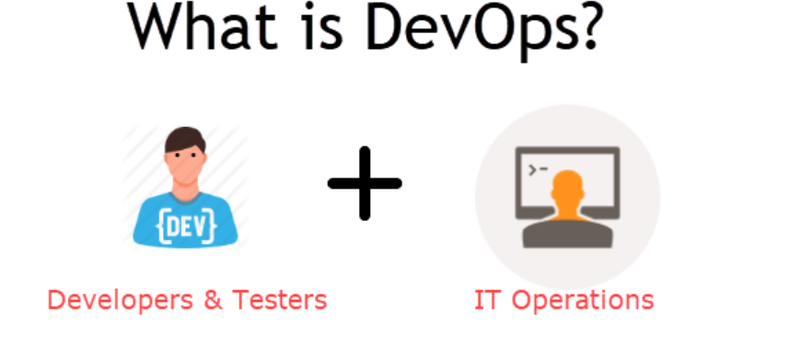
WHAT IS DEVOPS
DevOps is a culture which promotes collaboration between Development and Operations Team to deploy code to production faster in an automated & repeatable way. The word 'DevOps' is a combination of two words 'development' and 'operations.'
DevOps helps to increases an organization's speed to deliver applications and services. It allows organizations to serve their customers better and compete more strongly in the market.
In simple words, DevOps can be defined as an alignment of development and IT operations with better communication and collaboration.

Slide 3
Why is DevOps is Needed?
Before DevOps, the development and operation team worked in complete isolation.
Testing and Deployment were isolated activities done after design-build. Hence they consumed more time than actual build cycles.
Without using DevOps, team members are spending a large amount of their time in testing, deploying, and designing instead of building the project.
Manual code deployment leads to human errors in production
Coding & operation teams have their separate timelines and are not in synch causing further delays.
There is a demand to increase the rate of software delivery by business stakeholders. As per Forrester Consulting Study, Only 17% of teams can use delivery software fast enough. This proves the pain point.

Slide 4
How is DevOps different from traditional IT
Let's compare traditional software waterfall model with DevOps to understand the changes DevOps bring.
We assume the application is scheduled to go live in 2 weeks and coding is 80% done. We assume the application is a fresh launch and the process of buying servers to ship the code has just begun-

Slide 5
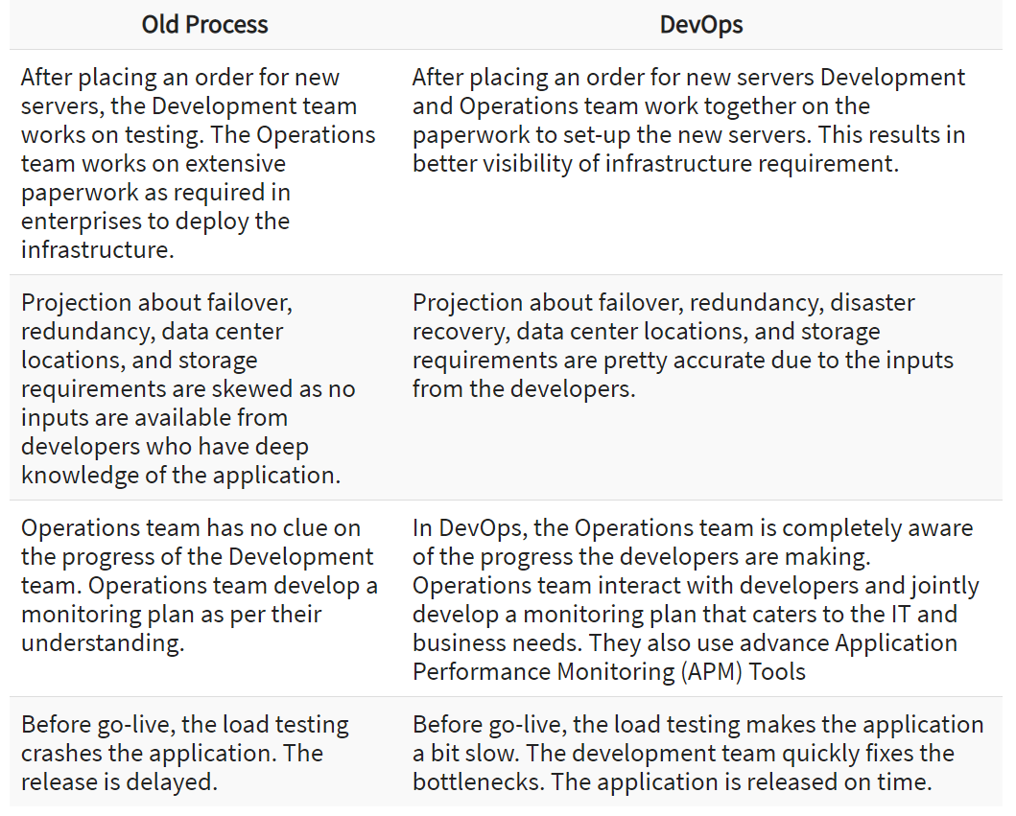
Traditional IT VS DEVOPS

Slide 6
Why is DevOps used?
DevOps allows Agile Development Teams to implement Continuous Integration and Continuous Delivery. This helps them to launch products faster into the market.
Other Important reasons are:
Predictability: DevOps offers significantly lower failure rate of new releases
2. Reproducibility: Version everything so that earlier version can be restored anytime.
3. Maintainability: Effortless process of recovery in the event of a new release crashing or disabling the current system.
4. Time to market: DevOps reduces the time to market up to 50% through streamlined software delivery. This is particularly the case for digital and mobile applications.
5. Greater Quality: DevOps helps the team to provide improved quality of application development as it incorporates infrastructure issues.

Slide 7
Continue
6. Reduced Risk: DevOps incorporates security aspects in the software delivery lifecycle. It helps in reduction of defects across the lifecycle.
7. Resiliency: The Operational state of the software system is more stable, secure, and changes are auditable.
8. Cost Efficiency: DevOps offers cost efficiency in the software development process which is always an aspiration of IT companies' management.
9. Breaks larger code base into small pieces: DevOps is based on the agile programming method. Therefore, it allows breaking larger code bases into smaller and manageable chunks.

Slide 8
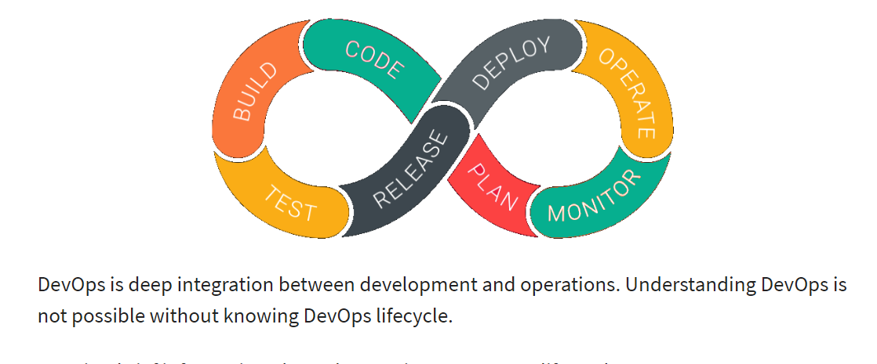
DEVOPS LIFECYCLE

Slide 9
DEVOPS LIFECYCLE
Here is a brief information about the Continuous DevOps life-cycle:
1. Development
In this DevOps stage the development of software takes place constantly. In this phase, the entire development process is separated into small development cycles. This benefits DevOps team to speed up software development and delivery process.
2. Testing
QA team use tools like Selenium to identify and fix bugs in the new piece of code.
3. Integration
In this stage, new functionality is integrated with the prevailing code, and testing takes place. Continuous development is only possible due to continuous integration and testing.
4. Deployment
In this phase, the deployment process takes place continuously. It is performed in such a manner that any changes made any time in the code, should not affect the functioning of high traffic website.
5. Monitoring
In this phase, operation team will take care of the inappropriate system behavior or bugs which are found in production.
NO
YES
NO
YES

Slide 10
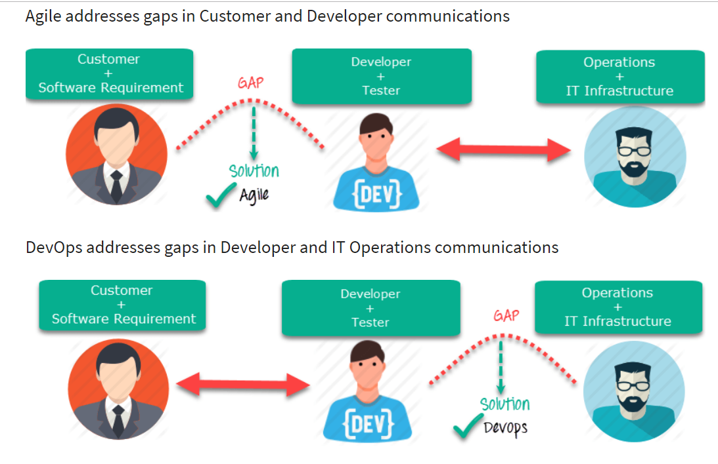
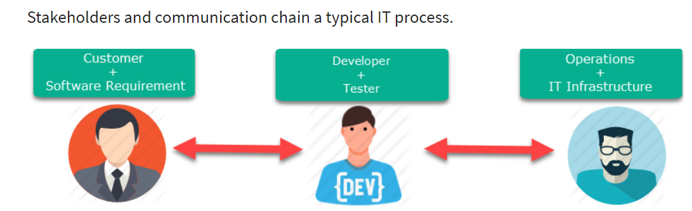
How is DevOps different from Agile?

Slide 11
DevOps Principles
Here, are six principles which are essential when adopting DevOps:
Customer-Centric Action: DevOps team must take customer-centric action for that they should constantly invest in products and services.
2. End-To-End Responsibility: The DevOps team need to provide performance support until they become end-of-life. This enhances the level of responsibility and the quality of the products engineered.
3. Continuous Improvement: DevOps culture focuses on continuous improvement to minimize waste. It continuously speeds up the improvement of product or services offered.
4. Automate everything: Automation is a vital principle of DevOps process. This is not only for the software development but also for the entire infrastructure landscape.
5. Work as one team: In the DevOps culture role of the designer, developer, and tester are already defined. All they needed to do is work as one team with complete collaboration.
6. Monitor and test everything: It is very important for DevOps team to have a robust monitoring and testing procedures.

Slide 12
DevOps Automation Tools
It is vital to automate all the testing processes and configure them to achieve speed and agility. This process is known as DevOps automation.
The difficulty faced in large DevOps Team that maintain large huge IT infrastructure can be classified briefly into six different categories.
Infrastructure Automation
Configuration Management
Deployment Automation
Performance Management
Log Management
Monitoring.

Slide 13
DevOps Automation Tools
Infrastructure Automation
Amazon Web Services (AWS): Being cloud service you do not need to be physically present in the data center. Also, they are easy to scale on-demand. There are no up-front hardware costs. It can be configured to provision more servers based on traffic automatically.
Configuration Management
Chef: It is a useful DevOps tool for achieving speed, scale, and consistency. It can be used to ease out complex tasks and perform configuration management. With this tool, DevOps team can avoid making changes across ten thousand servers. Instead, they need to make changes in one place which is automatically reflected in other servers.
Deployment Automation
Jenkins: This tool facilitates continuous integration and testing. It helps to integrate project changes more easily by quickly finding issues as soon as a built is deployed.

Slide 14
Continuous
Log Management
Splunk: This is a tool solves the issues like aggregating, storing, and analyzing all logs in one place.
Performance Management
App Dynamic: It is DevOps tool which offers real-time performance monitoring. The data collected by this tool helps developers to debug when issues occur.
Monitoring
Nagios: It is also important to make sure people are notified when infrastructure and related services go down. Nagios is one such tool for this purpose which helps DevOps teams to find and correct problems.

Slide 15
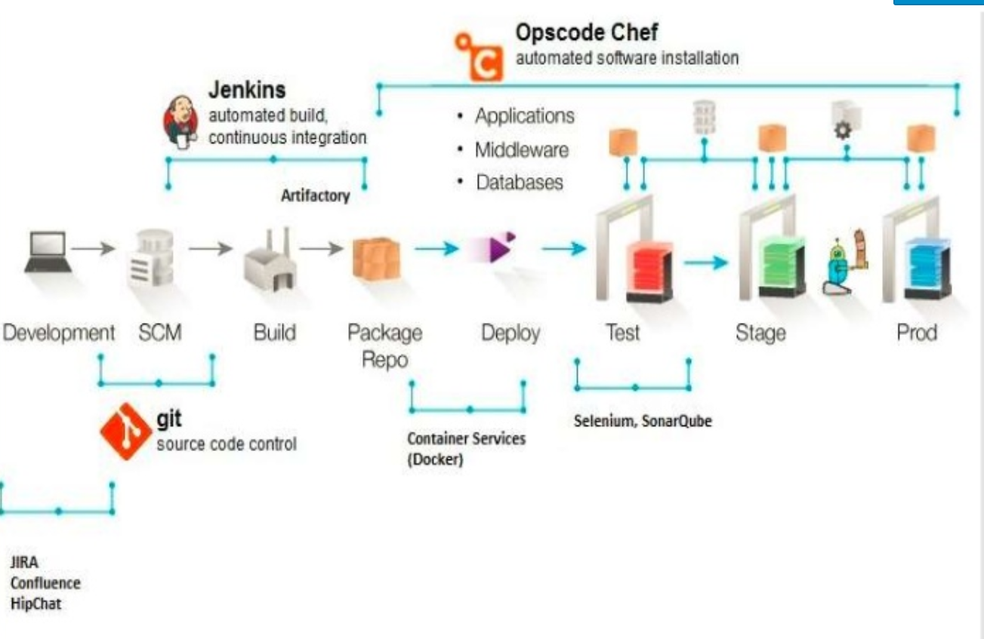
Devops Architecture

Slide 16
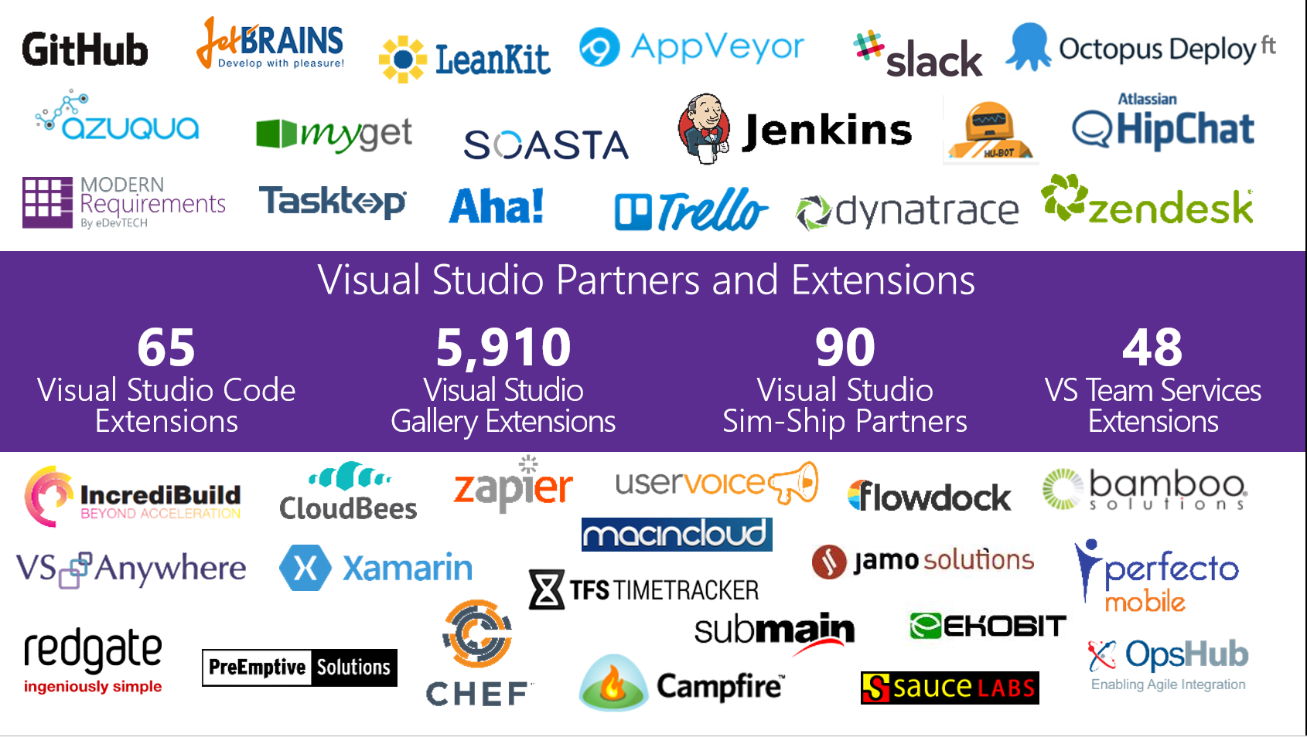
Devops Tools

Slide 17
THANK YOU !
- KARTHIK SIVAKUMAR

